Slide 1
Project Procurement

Slide 2


Porter’s Value Chain
Firm Infrastructure
Human Resources Management
Technology Development
Procurement
Inbound
Logistics
Operations
Outbound
Logistics
Marketing &
Sales
Service
Porter’s value chain showing support activities and primary activities.
Notes:
To illustrate the importance of the procurement process.

Slide 3



















Slide 4
Key factors in evaluating Vendors for MIS
Possess long-range plans for support of the product.
Possess a good corporate reputation for reliability
Reflect financial stability
Possess a high credibility rating in the industry
Provide staff with in-depth industrial knowledge and background
Possess an intimate knowledge of their product
Be totally committed to the support of the product
Be easily accessible and available to clients
Provide an effective implementation program
Provide additional services as needed to support the product
Maintain effective communication with users
Encourage user interaction and involvement
Provide for a well-defined maintenance plan

Slide 5














Slide 6
Project Procurement Management
The processes related to the purchase of products, services or results necessary to perform the work.
Includes contract management and change control processes required to administer contracts or purchase orders issued by authorized project team members.
Also includes administering any contract issued by an outside organization (the buyer) that is acquiring the project from the performing organization (the seller), and administering contractual obligations placed on the project team by the contract

Slide 7
Project Procurement Management
Plan purchases and acquisitions
Determining what to purchase and determining when and how to do so.
Plan contracting
Documenting products, services and results requirements and identifying potential sellers
Request seller responses
Obtaining information, quotations, bids, offers or proposals
Select sellers
Reviewing offers, choosing among potential sellers and negotiating a written contract with each seller
Contract administration
Managing the contract and relationship between the buyer and seller, reviewing and documenting how a seller is performing or has performed to establish required corrective actions and provide a basis for future relationships with the seller. Managing contract related changes and managing the relationship with the outside buyer of the project
Contract closure
Completing and settling each contract including the resolution of any open items, and closing each contract applicable to the project or a project phase.

Slide 8
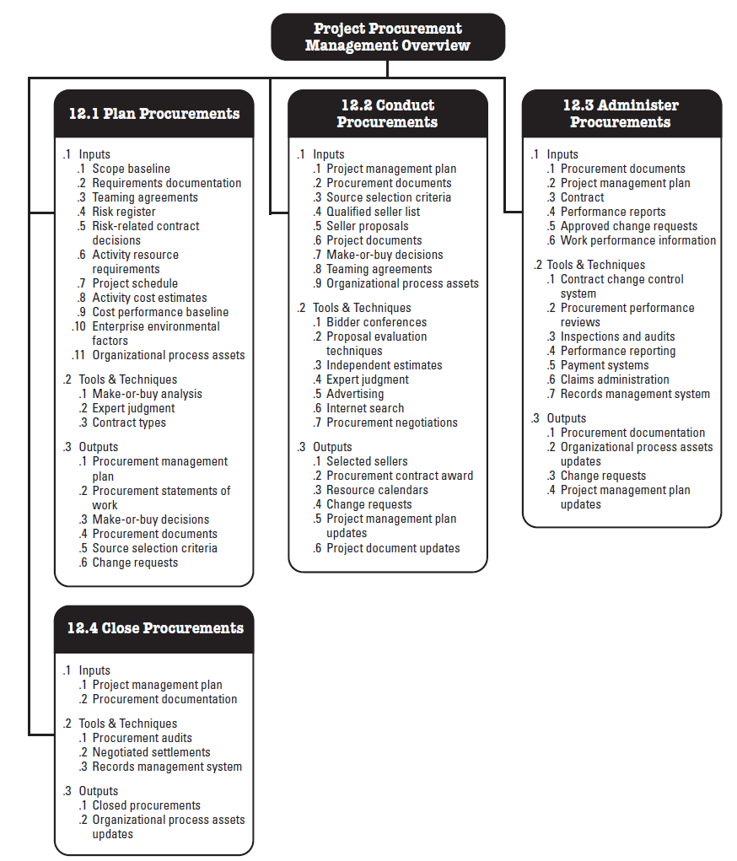
From PMBOK 4th Edition

Slide 9
Contract
A mutually binding agreement that obligates the seller to provide the specified products, services or results and obligates the buyer to provide monetary or other valuable consideration.
A contract is a legal relationship subject to remedy in the courts. Some agreements are simple others are complex. Contracts can reflect the simplicity or complexity of the deliverables.
Depending on the application area, contracts can also be called an agreement, subcontract, or purchase order.
Most organizations have well documented policies and procedures specifying who can enter into agreements on the organization’s behalf.

Slide 10
Plan purchases and acquisitions
The Plan Purchases and Acquisition process provides a pattern which can be used to determine which needs are better met by using an outside organization versus the project team. Common inputs to this decision is when the result is needed and how best to obtain the result.
As with all processes, there are inputs to the Plan Purchases and Acquisitions Process. These inputs provide the foundation for determining what, when, and how to purchase. These input are given next.

Slide 11
Inputs
Enterprise Environmental Factors – Enterprise environmental factors concerning mark conditions. What products, services, and results are available in the marketplace? Where can you obtain them? Are there terms and conditions which are applicable? Is there a legal or purchasing department? Or is that the project teams responsibility?
Organizational Process Assets – Organizational process assets depicts whether formal or informal policies and procedures exist for dealing with procurement within the organization. Some common types of organizational process assets are, all requisitions for purchase orders must be signed by the CIO. All purchase requisitions above $2000 must be initialed by all EVPs. All vendors must have been in business for a period of at least 3 years.
Project Scope Statement – Project Scope Statement details the projects boundaries, requirements, constraints, and assumptions. Check out the constraints in the project scope statement to see if there are any required delivery dates or need for skilled resources.
Work Breakdown Structure – The Work Breakdown structure illustrates how each work package’s interdependencies.
WBS Dictionary – The WBS Dictionary details the work needed to complete each WBS package. Check out the contract info and quality needs when reviewing for the planning and acquisition process.
Project Management Plan – Check out the following items: Risk register, Risk related contractual agreements, Activity resource requirements, Project schedule, Activity cost estimates, Cost baseline.

Slide 12
Make-or-buy Decisions - Make-or-buy analysis involves comparing the relative benefits of in-house versus out-sourcing production of a given product, service, or result. Common considerations are if the skill set in house is capable of delivering the product or service and if the same quality or a higher standard can be obtained from outside.
Expert Judgment - Expert judgment brings in specialized advice, such as technical, legal, or market knowledge, to inform buying decisions. Sometimes using experts can bring about new approaches which simply were not considered without the expertise or experience of being one that has already been there done that.
Contract Types - Contract Types are the types of contracts available for use. Different contracts are used for different purposes and intents. Generally there are three main categories:

Slide 13
Contract Types
Contract Types - Different contracts are used for different purposes and intents. Generally there are three main categories:
Fixed-price or lump-sum contracts – Generally involves a total price for a well-defined product. Fixed-price contracts may include incentives for early delivery. Buying shrink wrapped software is commonly a fixed price contract.
Cost-reimbursable contracts – Generally involves payment to the vendor for actual cost plus a fee for profit. Actual costs comprise direct and indirect cost of making the product or providing the service. There are three common types of cost-reimbursable contracts.
Cost-Plus-Fee (CPF) or Cost-Plus-Percentage of Cost (CPPC) – the seller is reimbursed for the allowable costs and receives a percentage of the costs as a fee.
Cost-Plus-Fixed-Fee (CPFF) – the vendor is reimbursed for allowable costs and receives a fixed fee. The fee normally doesn’t change unless scope changes allocate a new fee.
Cost-Plus-Incentive-Fee (CPIF) – Cost-Plus-Incentive reimburses the seller for allowable costs and allocates a predetermined fee, as an incentive for achieving certain performance objectives.
Time and Material contracts –a hybrid combination of cost-reimbursable and fixed price contracts. A common indicator is their open-ended nature. The full value of the agreement and the exact quantity of items to be delivered are not defined at the time of contract award.

Slide 14
Outputs
Procurement Management Plan – The procurement management plan explains how procurement will be managed from inception to closing. Commonly the procurement management plan details the types of contracts to be used, who is accountable for estimates, the guidelines for the build or buy decision. What are the common lead times and how best to handle them? Finally what is the form and format of the statement of work?
Contract Statement of Work (SOW) - The contract statement of work explains the items being purchased with enough detail and clarifications for everyone to be in agreement with what is being purchased. The contract statement of work should have a clear concise description of the services needed and operational support.
Make-or-buy Decisions – Make or buy decisions are pretty self explanatory as to the purpose. However, it is good to have a document with a list of the justification for the decision and responsible party.
Requested Changes – Requested changes to the plan should be placed into the integrated change control process.

Slide 15
Plan Contracting
Prepares the documents need to support the Request Seller Responses process and Select sellers process

Slide 16
Inputs
Procurement management plan
Contract statement of work
Make or buy decisions – list of items to be purchased those to be produced by the project team
Project management plan
Risk register – risk related information such as identified risks, root causes of risks, risk owners, risk analysis results, risk prioritization, risk categorization and risk responses generated by the risk management process.
Risk related contractual agreements – agreements for insurance, services etc that are prepared to specify each party’s responsibility for specific risks.
Resource requirements
Project schedule
Activity cost estimate
Cost baseline

Slide 17
Tools and techniques
Standard forms – include standard contracts, standard descriptions of procurement items, non-disclosure agreements, proposal evaluation criteria checklists, or standardized versions of all parts of the needed bid documents.
Expert judgement - often required to assess the inputs to and outputs from a process. Expert purchasing judgement can also be used to evaluate offers or proposals made by sellers. Expert legal judgement may involve the services of a lawyer to assist with non-standard procurement terms and conditions.

Slide 18
Outputs
Procurement documents – used to seek proposals from prospective sellers. A term such as bid, tender, or quotation is generally used when the seller selection decision will be based on price (when buying commercial or standard items), while a term such as proposal is generally used when other considerations, such as technical skills or technical approach, are paramount. Common names are “invitation to bid,” “request for proposal,” “request for quotation,” “tender notice,” “invitation for negotiation,” and “contractor initial response.” Procurement documents are structured to facilitate an accurate and complete response from prospective sellers and to facilitate easy evaluation of the bids.
Evaluation criteria – used to rate or score proposals. Can be objective or subjective. Can be limited to purchase price, but often other criteria need to be taken into consideration. E.g. understanding of need, overall or life-cycle cost, technical capability, management approach, technical approach, financial capacity and interest, references, intellectual property rights, proprietary rights.
Contract statement of work (updates)

Slide 19
Request Seller Responses
Obtains responses such as bids and proposals, from prospective sellers on how project requirements can be met. The prospective sellers, normally at no direct cost to the project or buyer, expend most of the actual effort in this process.
Inputs | Tools and Techniques | Outputs
Organizational process assets Procurement management plan Procurement documents | Bidder conferences Advertising Develop qualified sellers list | Qualified sellers list Procurement document package Proposals

Slide 20
Inputs
Organization Process Assets – some organizations maintain lists or files with information on prospective and previously qualified sellers (sometimes called bidders) who can be asked to bid, propose, or quote on work. These lists will generally have information on relevant past experience and other characteristics of the prospective sellers.
Procurement management plan – describes how the procurement process will be managed from developing procurement documentation through to contract closure. Possible includes: contract types, who prepares estimates, standardized procurement documents, managing multiple providers, coordinating procurement with other project aspects like scheduling, etc.

